Slide 1

Web Development
Prepare by
Harmik Rathod(24010101680)

Slide 2
What is Web Development?
Web development refers to the process of creating and maintaining websites or web applications. It involves several aspects, including:
Front-end Development: Deals with the user interface and experience, using technologies like HTML, CSS, and JavaScript.
Back-end Development: Manages the server, database, and application logic using languages like Node.js, Python, or PHP.
Full-stack Development: Combines both front-end and back-end development.
Web Hosting & Deployment: Involves making the website accessible via the internet using hosting services.

Slide 3
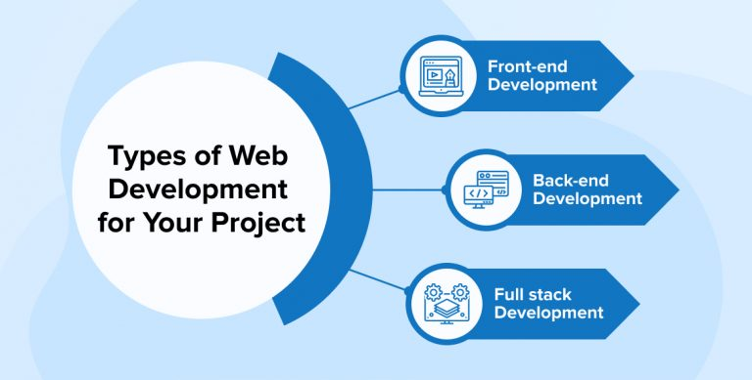
Types of Web Development

Slide 4
Frontend Development
The Face of the Web. The part of a website where the user interacts directly is termed as front end. This involves designing the structure, layout, and behavior of the website It is also referred to as the ‘client side’ of the application.
🔹 Key Technologies: HTML, CSS, JavaScript 🔹 Popular Frameworks: Bootstrap, React, Angular, Vue.js 🔹 Core Concepts: Responsive Design, UI/UX, Cross-Browser Compatibility 🔹 Tools Used: VS Code, Git, npm

Slide 5
Backend Development
The Backbone of the Web. Backend is the server side of a website. It is part of the website that users cannot see and interact with. It is the portion of software that does not come in direct contact with the users. It is used to store and arrange data.
🔹 Key Backend Technologies: Node.js, Python, Java, PHP 🔹 Databases Used: MySQL, MongoDB, PostgreSQL 🔹 Core Functions: Data storage, authentication, APIs 🔹 Popular Frameworks: Express.js, Django, Spring Boot

Slide 6
Full Stack Development
Full-stack development refers to the practice of developing both the frontend and backend of a website or web application. Full-stack developers have a deep understanding of both areas and can build end-to-end solutions.
🔹 Key Technologies Used
Frontend: HTML, CSS, JavaScript, React, Angular
Backend: Node.js, Django, Spring Boot
Database: MySQL, MongoDB, PostgreSQL
🔹 Popular Full-Stack Frameworks
MERN (MongoDB, Express.js, React, Node.js)
MEAN (MongoDB, Express.js, Angular, Node.js)
LAMP (Linux, Apache, MySQL, PHP)

Slide 7
Thank You
web development is not just about code; it's about creating experiences that inspire and connect people worldwide

